Slide 1

CVSCL Vision 2023
Ashish Mendiratta
General Secretary, CVSCL

Slide 2

What Binds us together
PURPOSE
Beyond the Realms of Professional Boundaries

Slide 3

Our Mission
‘
Through cross-learning, collaboration and collective thought leadership
Be a catalyst and voice for Supply Chain excellence, intellectual growth and success

Slide 4
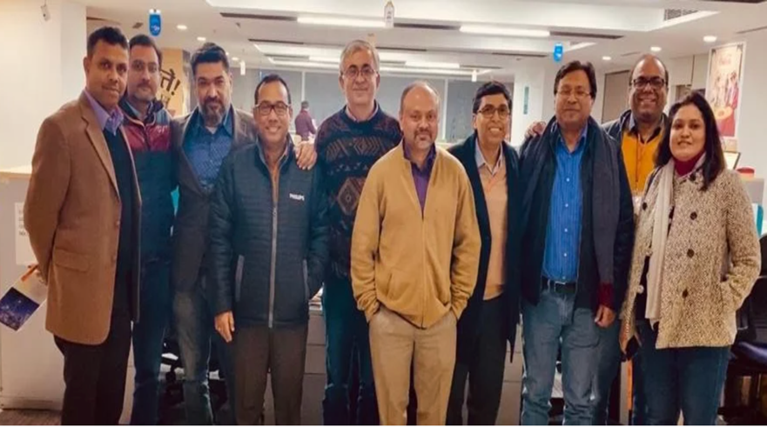
VISION 2023
Enroll 200+ senior supply chain professionals from companies, academia cutting across major various sectors
‘
Be the leading & largest community of Supply Chain Leaders in India, representing all leading sectors

Slide 5

VISION 2023
Collaboration in the areas of shared logistics, collective negotiation, developing sectoral best practices
‘
Drive Collaboration Projects across to create business value for the members’ companies

Slide 6
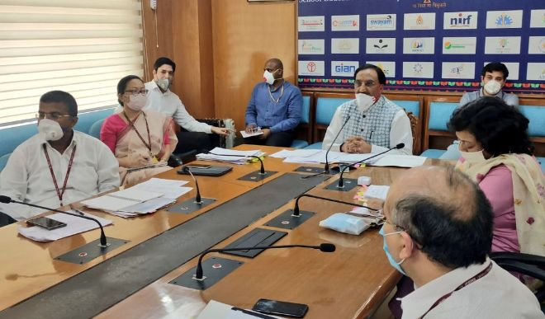
representing all leading sectors
VISION 2023
Establish connects, advise and collaborate with Ministry of Commerce and Industry bodies on logistics policy matters
‘
Be the leading voice of supply chain for influencing the government policies

Slide 7

representing all leading sectors
VISION 2023
Invite startup companies to present their value proposition and provide opportunities for testing and proof of concept
‘
Provide a platform to Startup companies to encourage innovation in Supply Chain

Slide 8

representing all leading sectors
VISION 2023
Conduct studies in collaboration with consulting companies, build & share repository of knowledge & best practices contributed by the members
‘
Be a point of reference for the Supply Chain Best Practices & Knowledge

Slide 9
representing all leading sectors
VISION 2023
Talks, coaching & mentoring the college students & early career professions by the members
‘
Promote the Supply Chain Profession among Youth & Early Career Professionals

Slide 10
representing all leading sectors
President
Vice President
General Secretary
Initiatives Leads
Treasurer
Collaborative Projects
Institutional Connects
Start-ups Connect
Academia, Studies, Surveys
Events
‘
Governing body mirrors The vision

Slide 11
Key Achievements 2019-2020
Monthly Round Tables – Physical & Virtual
Initiated 2 Collaboration Projects
Invited 6 startup companies for presenting their ideas to the members
Conducted 2 short Studies / Surveys
Delivered 5 talks in colleges on Supply Chain Career
Brought out 2 Issues of Magazine ”Visionaire”

Slide 12
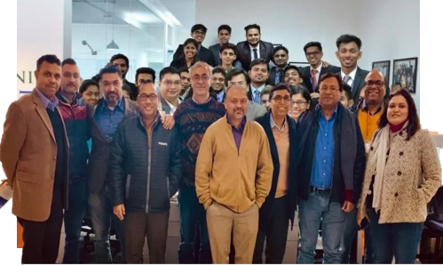
Last Word
मैं अकेला ही चला था जानिब-ए-मंज़िल मगर
लोग साथ आते गए और कारवाँ बनता गया
I set off alone towards my goal, but people came along, and it began to turn into a caravan
Majrooh Sultanpuri

Slide 13

Thank you

